Slide 1
Simplify API Consumption
Using Refit

Slide 2






About your speaker
Microsoft MVP, ASPInsider
CEO @ IowaComputerGurus, Inc
Contact Information
msellers@iowacomputergurus.com
@mitchelsellers
Github.com/mitchelsellers
www.mitchelsellers.com
MITCHEL SELLERS
2
www.computergurus.com

Slide 3
Agenda
Problem Statement
Examples of Current/Standard Examples
What is Refit?
How to Use it?
Examples

Slide 4
Problem Statement
We spend too much time writing boiler-plate code to consume API’s, wasting valuable developer resources for tedious tasks.
Strongly structured patterns, are hard to implement, and even harder to unit test, etc.
We want developers spending time on the major development tasks

Slide 5
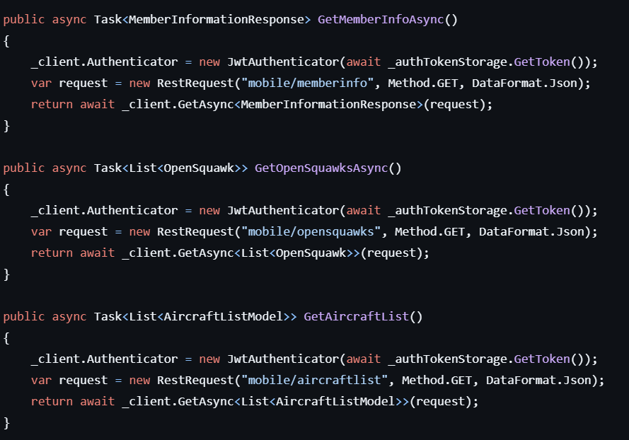
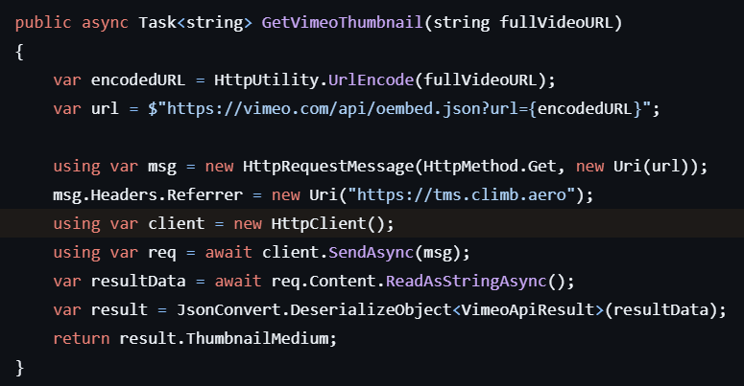
Examples of Current Solutions
Very common to see “wrappers” around HttpClient
Resulting in improper usage of resources
Lots of manual processing, or manual/repeated code
Even with other libraries, lots of repeated code/processes, RestSharp is a common element

Slide 6
What is Refit
An open-source library that “turns your REST API into a live interface”
By simply defining an interface, with proper attributes, you can get a fully functional client for calling APIs
Reducing boilerplate
Creating consistency
Allowing faster development

Slide 7
How to Use It
Install NuGet Packages
Install-package refit
Install-package refit.httpclientfactory
Setup your interface
Configure the httpfactory
builder.Services.AddRefitClient<IApi>() .ConfigureHttpClient(c => c.BaseAddress = new Uri(baseUrl));
Simply inject your interface where needed!

Slide 8
Building Your API Interface
Attributes drive structure
[Get(“/Path”)]
[Post(“/Path”)]
Response Type Defines Methods
Task – Throw away response
Task<string> - Raw content response (JSON/XML)
IObservable<HttpResponseMessage> - Raw HTTPResponse
Task<IApiResponse<T>> - a wrapper around your object
Helpful for checking other values
Example
[Post("/product")] Task<ProductDto> AddProduct([Body] ProductDto product);

Slide 9
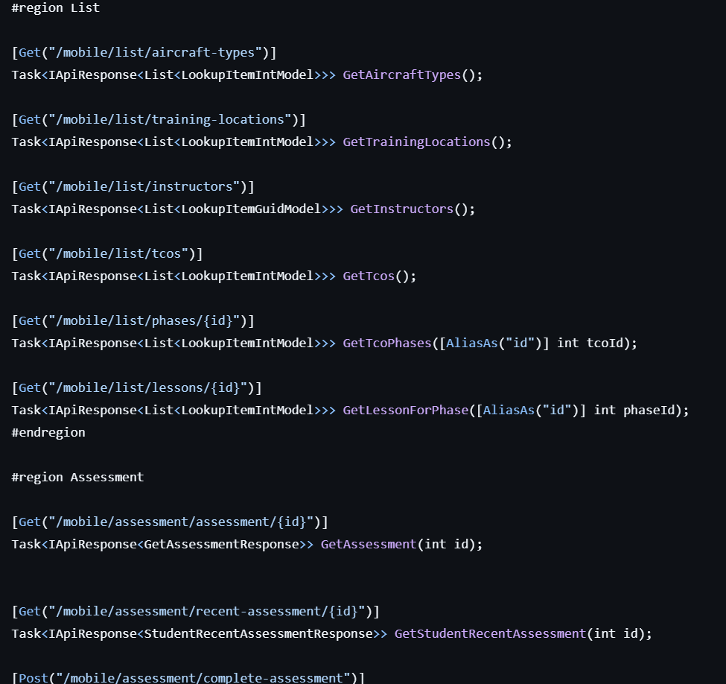
API

Slide 10
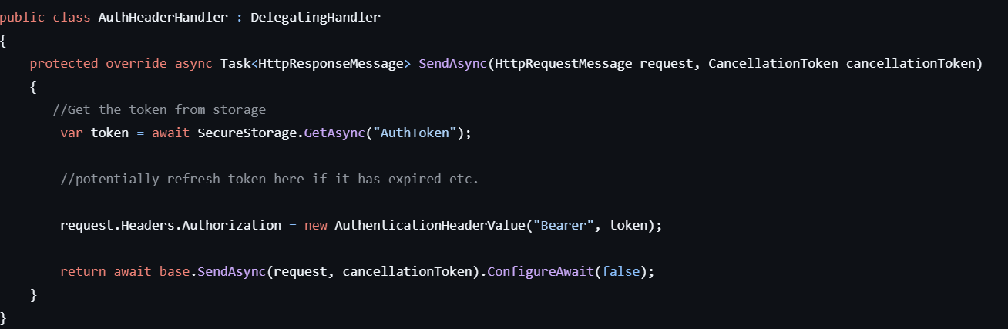
Adding Auth Headers

Slide 11
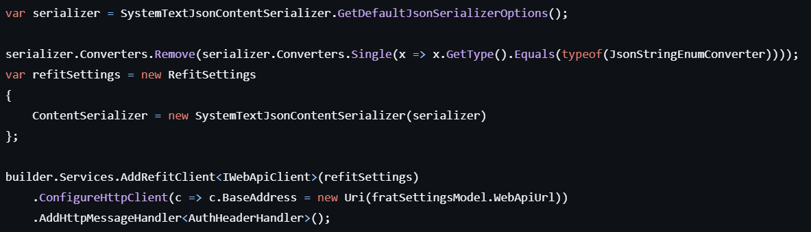
Wiring It All Up

Slide 12
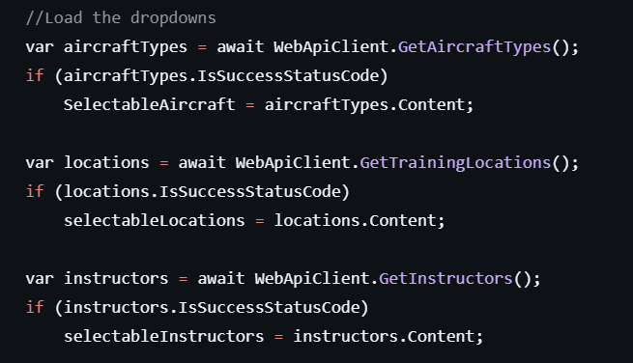
Using the API

Slide 13
Taking Things Further
Exposing HttpClient
Simply add “HttpClient Client { get; }” to your API
Allows customization of the client
For example allowing expansion of timeout if needed
Exception Handling
IApiResponse
Easy way to handle, wraps errors, and focuses on 200-299
Other Types
Must capture the exception, ApiException captures all
Can be a ValidationApiException if return type is application/problem+json

Slide 14
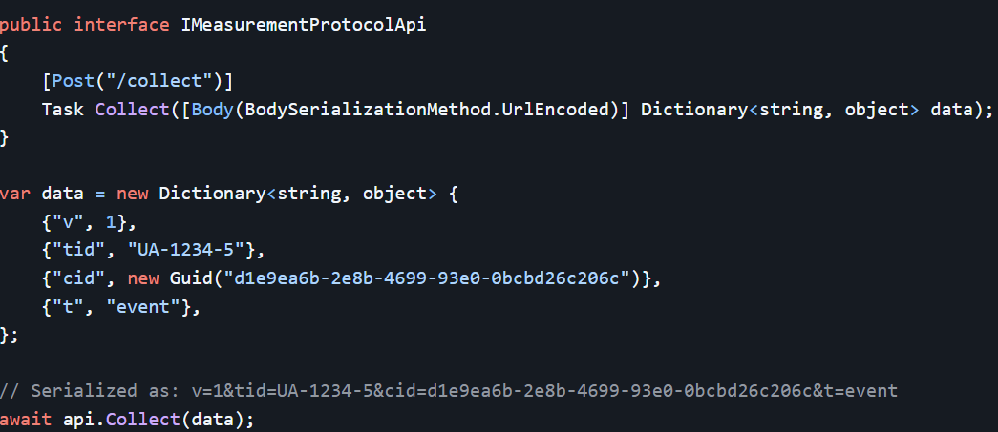
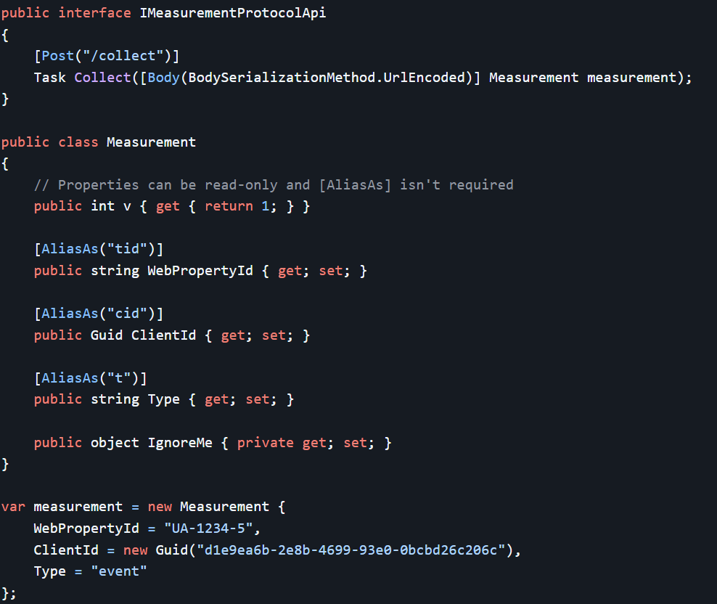
Traditional Form Post (Url-Encoded)

Slide 15
Lets Explore Code
https://github.com/mitchelsellers/aspnet-webapi-refit-demo

